Slide 1

ECE 2700
Digital Circuits
ALUs and Shifters
Copyright © 2010 Frank Vahid
Instructors of courses requiring Vahid's Digital Design textbook (published by John Wiley and Sons) have permission to modify and use these slides for customary course-related activities, subject to keeping this copyright notice in place and unmodified. These slides may be posted as unanimated pdf versions on publicly-accessible course websites.. PowerPoint source (or pdf with animations) may not be posted to publicly-accessible websites, but may be posted for students on internal protected sites or distributed directly to students by other electronic means. Instructors may make printouts of the slides available to students for a reasonable photocopying charge, without incurring royalties. Any other use requires explicit permission. Instructors may obtain PowerPoint source or obtain special use permissions from Wiley – see http://www.ddvahid.com for information.

Slide 2
Today’s Objective
To become familiar with the following combinational datapath components
  ALU
  Shifter

Slide 3
Multifunction Arithmetic Logic
One design to the right
Drawbacks
  Wasted area and power
  Complicated wiring
  Long delay
Observation
  Only need to perform one
  operation at a time
DIP switches
1
0
8
8
A
B
+
-
+1
AND
OR
X
OR
N
O
T
Wasted
8
power
8
8
8
8
8
8
8
A lot of wires
1
0
x
0
1
2
3
4
5
6
7
y
s2
8-bit 8x1
z
s1
s0
e
8
Id
8-bit
r
e
g
is
t
er
clk
C
A
L
C
8
LEDs

Slide 4
Arithmetic-Logic Unit (ALU)
Component that can perform various arithmetic (add, subtract, increment, etc.) and logic (AND, OR, etc.) operations, based on control inputs
Inputs |  |  | Operation | Sample Output if A = 00001111 B = 00000101
x | y | z
0 | 0 | 0 | S = A + B | 00010100
0 | 0 | 1 | S = A - B | 00001010
0 | 1 | 0 | S = A + 1 | 00010000
0 | 1 | 1 | S = A | 00001111
1 | 0 | 0 | S = A AND B (bitwise AND) | 00000101
1 | 0 | 1 | S = A OR B (bitwise OR) | 00001111
1 | 1 | 0 | S = A XOR B (bitwise XOR) | 00001010
1 | 1 | 1 | S = NOT A (bitwise complement) | 11110000

Slide 5
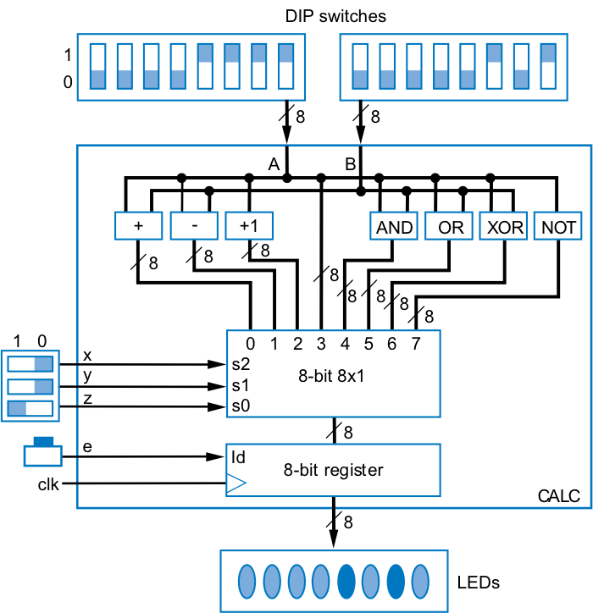
ALU Use
More elegant and efficient
DIP switches
1
1
0
0
8
8
A
B
x
A
B
y
x
ALU
z
y
z
S
8
e
ld
clk
8-bit register
8
C
A
L
C
LEDs

Slide 6
ALU Design
ALU design uses single adder, plus logic in front of adder’s A and B inputs
  Logic in front is called an arithmetic-logic extender
  Extender modifies A and B inputs so desired operation appears at output of the adder
a7
b7
a6
b6
a0
b0
x
AL-extender
y
AL-extender
x
z
y
z
I
A
I
B
abext
abext
abext
cinext
Adder
cin
I
S
ia7
ib7
ia6
ib6
ia0
ib0
cin
ALU
S

Slide 7
AL Extender Design
Inputs |  |  | Operation | Sample Output if A = 00001111 B = 00000101 | AL Logic
x | y | z
0 | 0 | 0 | S = A + B | 00010100
0 | 0 | 1 | S = A - B | 00001010
0 | 1 | 0 | S = A + 1 | 00010000
0 | 1 | 1 | S = A | 00001111
1 | 0 | 0 | S = A AND B (bitwise AND) | 00000101
1 | 0 | 1 | S = A OR B (bitwise OR) | 00001111
1 | 1 | 0 | S = A XOR B (bitwise XOR) | 00001010
1 | 1 | 1 | S = A’ (bitwise complement) | 11110000
i_{a} = a, i_{b}= b, cin = 0
i_{a} = a, i_{b}= b’, cin = 1
i_{a} = a, i_{b}= 0, cin = 1
i_{a} = a, i_{b}= 0, cin = 0
i_{a} = ab, i_{b}= 0, cin = 0
i_{a} = a+b, i_{b}= 0, cin = 0
i_{a}=a xor b, i_{b}= 0, cin = 0
i_{a} = a’, i_{b}= 0, cin = 0
x
y
AL-extender
z
I
A
I
B
Adder
cin
I
S
ALU
S

Slide 8
Shifters (Revisited)
Shifting useful for
  Manipulating bits
  Converting serial data to parallel
  Multiply/divide by 2 (unsigned numbers only)
i3
i2
i1
i0
i3
i2
i1
i0
i3
i2
i1
i0
in
inR
inL
in
0
1
0
1
0
1
0
1
2
0
1
2
0
1
2
0
1
2
0
1
sh
shL
<<1
shR
Symbol
q3
q2
q1
q0
Left shifter
q3
q2
q1
q0
q3
q2
q1
q0
Shifter with left shift or no shift
Shifter with left shift, right shift, and no shift

Slide 9
Strength Reduction: Multiplication
Many multiplications not by power of 2 constants
  E.g., by 5, or 10
Could use multiplier component, but shifters are smaller and faster
  Replace multiplication with shifts and adds
Operator strength reduction (multiply is “stronger” than shift/add)
  E.g., 5*C → 4*C + C (4*C same as C<<2)

Slide 10
Strength Reduction: Division
Replacing division by shifts and adds slightly harder
Approximate fraction using fraction having power of 2 denominator
  E.g., C / 5 = 0.20 * C
    Approximately equals (102 / 512) * C = 0.199 * C
    (102 / 512) * C = C * (64 + 32 + 4 + 2) / 512
    = (C * 64 + C * 32 + C * 4 + C * 2) / 512
    = ((C<<6) + (C<<5) + (C<<2) + (C<<1)) >> 9

Slide 11
Question (AP)
Given the function F below, which of the following best express it if strength reduction were used?
  F = 10/4 * x + 10
  F = ((2+2+2+2+2) / 4) * x + 10
  F = ((4+4+2) / 4) * x + 10
  F = ((8+2) / 4) * x + 10
  F = ((5+5) / 4) * x + 10
  ☹

Slide 12
Barrel Shifter
A shifter that can shift by any amount
  4-bit barrel left shift can shift left by 0, 1, 2, or 3 positions
  8-bit barrel left shifter can shift left by 0, 1, 2, 3, 4, 5, 6, or 7 positions
    (Shifting an 8-bit number by 8 positions is pointless, as you just lose all the bits)
Could design using 8x1 muxes
  Too many wires

Slide 13
Barrel Shifter Design
Very elegant
  Chain three shifters: 4, 2, and 1
  Can achieve any shift of 0..7 by enabling the correct combination of those three shifters, i.e., shifts should sum to desired amount
Q: xyz=??? to shift by 5?
I
8
00000110
1
x
sh
<<4
in
0
8
01100000
0
y
sh
<<2
in
0
1
8
01100000
z
sh
<<1
in
0
Net result: shift by 5:
8
11000000
Q

Slide 14
Today’s Objectives
To become familiar with the following combinational datapath components
  ALU
  Shifter

Slide 15
Question
Consider an ALU with inputs A and B. If one of the ALU operations is S = B – A, what would the AL logic look like? Specifically, what would IA, IB, and cin be set to?
A
B
x
y
AL-extender
z
I
A
I
B
Adder
cin
I
S
ALU
S

